Slide 1

Github Workshop
By
Janluis Rivera Gonzalez
Software Developer

Slide 2
What is GitHub?
A source version controller.

Slide 3
What is a source version controller?
Is a system that records changes to a file or set of files over time so that you can recall specific versions later.
For more information Visit Git Page.

Slide 4
Most used version controllers

Slide 5
Witch one is better?
Is more a matter of witch software fits better your development team and tools.

Slide 6
Why is Git different?
The main difference between Git and others source controllers is the way the data is stored. Others version controllers (CVS, Subversion, Perforce, etc) stored their data by keeping a set of files and the changes made to each file over time. Git operates differently, they treat their data more like a set of snapshots of a miniature file system. Every time a commit, or save, is made in the project it basically takes a picture of what all your files look like at that moment and stores a reference to that snapshot.
For more information on how Git works Visit Git Doc.

Slide 7
Setup GitHub Account
Go to GItHub Homepage (github.com)

Slide 8
Pick your Git clients

Slide 9
Teaching Moment!

Slide 10
Most commonly used commands
$ git commit -m "[descriptive message]”
$ git checkout [branch-name]
$ git stash
$ git pull
$ git push [alias] [branch]
$ git merge [branch]
For more commands and basic training Visit This Page.

Slide 11
Prove yourself!

Slide 12
Companies using Git

Slide 13
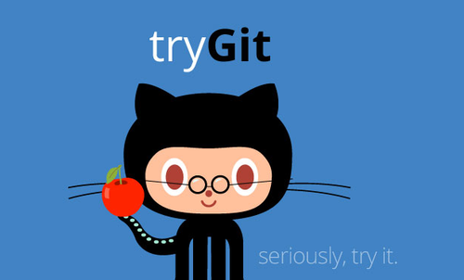
Thanks for your attention!
And..

